Slide 1
R
The Programming Language

Slide 2

R is a programming language and software environment for statistical analysis, graphics representation and reporting. R was created by Ross Ihaka and Robert Gentleman at the University of Auckland, New Zealand, and is currently developed by the R Development Core Team.
R is freely available under the GNU General Public License, and pre-compiled binary versions are provided for various operating systems like Linux, Windows and Mac.

Slide 3
The core of R is an interpreted computer language which allows branching and looping as well as modular programming using functions. R allows integration with the procedures written in the C, C++, .Net, Python or FORTRAN languages for efficiency.

Slide 4
Basic Syntax
To launch R prompt:
$ R
Print Hello World:
> print(“Hello World”)

Slide 5
R Script File
Usually, you will do your programming by writing your programs in script files and then you execute those scripts at your command prompt with the help of R interpreter called Rscript. So let's start with writing following code in a text file called test.
Save the above code in a file test.R and execute it at Linux command prompt as given below.
# My first program in R Programming myString <- "Hello, World!" print ( myString)
$ Rscript test.R
#Output
[1] "Hello, World!"

Slide 6
Data Types
In contrast to other programming languages like C and java in R, the variables are not declared as some data type. The variables are assigned with R-Objects and the data type of the R-object becomes the datatype of the variable. There are many types of R-objects. The frequently used ones are −
Vectors
Lists
Matrices
Arrays
Factors
Data Frames

Slide 7
Vectors
When you want to create vector with more than one element, you should use c() function which means to combine the elements into a vector.
# Create a vector. apple <- c('red','green',"yellow") print(apple)
# Output
[1] "red" "green" "yellow"

Slide 8
Lists
A list is an R-object which can contain many different types of elements inside it like vectors, functions and even another list inside it.
# Create a list. list1 <- list(c(2,5,3),21.3,sin)
[[1]] [1] 2 5 3
[[2]] [1] 21.3
[[3]] function (x) .Primitive("sin")

Slide 9
Matrices
A matrix is a two-dimensional rectangular data set. It can be created using a vector input to the matrix function.
# Create a matrix. M = matrix( c('a','a','b','c','b','a'), nrow = 2, ncol = 3, byrow = TRUE) print(M)
# Output
[,1] [,2] [,3] [1,] "a" "a" "b" [2,] "c" "b" "a"

Slide 10
Arrays
, , 1 [,1] [,2] [,3] [1,] "green" "yellow" "green" [2,] "yellow" "green" "yellow" [3,] "green" "yellow" "green" , , 2
[,1] [,2] [,3] [1,] "yellow" "green" "yellow" [2,] "green" "yellow" "green" [3,] "yellow" "green" "yellow"
While Matrices are 2 dimensional, arrays can have any number of dimension. It takes dim as an attribute which creates the required number of dimension.
# Create an array. a <- array(c('green','yellow'),dim = c(3,3,2)) print(a)

Slide 11
Data Frames
# Create the data frame. BMI <- data.frame( gender = c("Male", "Male","Female"), height = c(152, 171.5, 165), weight = c(81,93, 78), Age = c(42,38,26) ) print(BMI)
Data frames are tabular data objects. Unlike a matrix in data frame each column can contain different modes of data. The first column can be numeric while the second column can be character and third column can be logical. It is a list of vectors of equal length.
Data Frames are created using the data.frame() function.
gender height weight Age 1 Male 152.0 81 42 2 Male 171.5 93 38 3 Female 165.0 78 26

Slide 12
Types of Operators
Types of operators are:
Arithmetic Operators
Relational Operators
Logical Operators
Assignment Operators

Slide 13
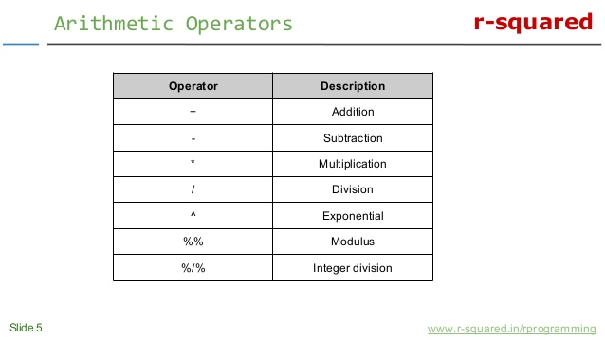
Arithmetic Operators

Slide 14
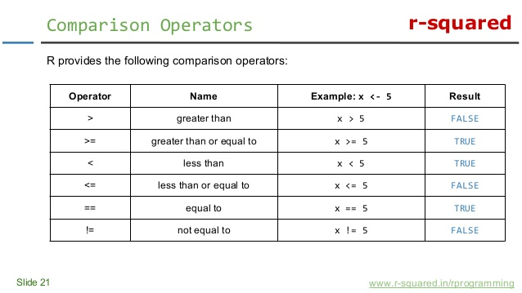
Comparison Operators

Slide 15
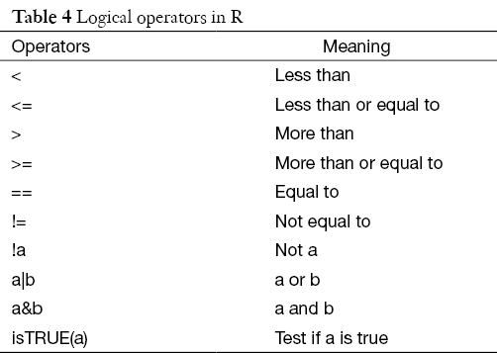
Logical Operators

Slide 16
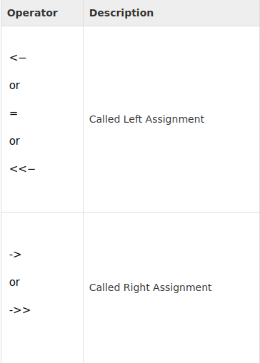
Assignment Operators

Slide 17
Decision Making
if...else Statement
Switch statement
if(boolean_expression) { // statement(s) will execute if the boolean expression is true. } else { // statement(s) will execute if the boolean expression is false. }
switch(expression, case1, case2, case3....)
x <- switch( 3, "first", "second", "third", "fourth" ) print(x)

Slide 18
Loops
for loop
while loop
repeat loop
The Repeat loop executes the same code again and again until a stop condition is met.
for (value in vector) { statements }
repeat { commands if(condition) { break } }
while (test_expression) { statement }

Slide 19
Functions
An R function is created by using the keyword function. The basic syntax of an R function definition is as follows −
A function is called using the function name along with the arguments given in parentheses.
function_name <- function(arg_1, arg_2, ...) { Function body }
function_name(arg_1, arg_2, …)

Slide 20
Functions
Calling a function with argument values by position:
Calling a function with argument values by name:
# Call the function by position of arguments. new.function(5,3,11)
# Call the function by names of the arguments. new.function(a = 11, b = 5, c = 3)

Slide 21
R Charts and Graphs
Pie Chart
In R the pie chart is created using the pie() function which takes positive numbers as a vector input. The additional parameters are used to control labels, color, title etc.
The basic syntax for creating a pie-chart using the R is −
pie(x, labels, main, col)
x is a vector containing the numeric values use in the pie chart.
labels is used to give description to the slices.
main indicates title of the chart.
col indicates color palette.

Slide 22
R Charts and Graphs
Bar Charts
R uses the function barplot() to create bar charts. R can draw both vertical and horizontal bars in the bar chart. In bar chart each of the bars can be given different colors.
The basic syntax to create a bar-chart in R is −
barplot(H, xlab, ylab, main, names.arg, col)
H is a vector containing numeric values in bar chart.
xlab and ylab are labels for x axis and y axis respectively.
names.arg is a vector of names appearing under each bar.

Slide 23
R Charts and Graphs
Scatterplots
Scatterplots show many points plotted in the Cartesian plane. Each point represents the values of two variables. One variable is chosen in the horizontal axis and another in the vertical axis.
The basic syntax for creating scatterplot in R is −
plot(x, y, main, xlab, ylab, xlim, ylim)
x and y are the data set whose values are the horizontal and vertical coordinates.
main is the title of the graph.
xlim and ylim are values of x and y for plotting.

Slide 24
R Charts and Graphs
Line Graphs
A line chart is a graph that connects a series of points by drawing line segments between them. These points are ordered in one of their coordinate (usually the x-coordinate) value.
The basic syntax to create a line chart in R is −
plot(v,type,col,xlab,ylab)
v is a vector containing the numeric values.
type takes the value "p" to draw only the points, "l" to draw only the lines and "o" to draw both points and lines.
xlab and ylab are labels for x and y axis respectively.
main is the title of the chart

Slide 25
Thank You

